Slide 1

Case Study: Database Clinic Management

Slide 2
Part 1 : Business Use Case
Problem Statement:
Modern clinics manage large volumes of patient data, appointments, billing, and prescriptions. Without a centralized system, data is fragmented, leading to inefficiencies and errors.
Objectives:
Digitally store and manage patient records
Schedule and track appointments
Handle billing and payments
Record prescriptions and medical histories
Data Requirements:
Patients (name, DOB, contact)
Doctors (name, specialization)
Appointments (date, doctor, patient)
Prescriptions (medications, dosage, patient)
Billing (amount, payment status)

Slide 3
Part 2 : Database Design
Business Definition Table
Entity | Description | Related Entities (Relationship Description)
Patient | Stores personal, contact, and demographic details of patients. | Has many Appointments, Receives Prescriptions, Gets Bills
Doctor | Contains details like name, specialization, and availability. | Conducts many Appointments, Issues Prescriptions
Appointment | Represents a scheduled meeting between a patient and a doctor. | Belongs to one Patient and one Doctor, Generates one Prescription and one Billing record
Prescription | Contains medication and dosage details for a patient after an appointment. | Linked to one Appointment, indirectly related to Doctor and Patient
Billing | Tracks charges, payments, and statuses for appointments. | Linked to one Appointment, indirectly to Patient

Slide 4
Part 2 : Database Design
Relationship
Relationship | Cardinality | Explanation
Patient → Appointment | 1:N | One patient can have many appointments
Doctor → Appointment | 1:N | One doctor can conduct many appointments
Appointment → Prescription | 1:1 | Each appointment results in one prescription
Appointment → Billing | 1:1 | Each appointment generates one billing record
Doctor → Prescription (via Appointment) | 1:N (indirect) | A doctor can issue multiple prescriptions through appointments
Patient → Billing (via Appointment) | 1:N (indirect) | A patient can have multiple bills through appointments

Slide 5
Part 2 : Database Design
Entity and Attributes
Entity | Attributes
Patient | PatientID (PK), FirstName, LastName, DateOfBirth, Gender, PhoneNumber, Email, Address
Doctor | DoctorID (PK), FirstName, LastName, Specialization, PhoneNumber, Email, AvailabilityStatus
Appointment | AppointmentID (PK), PatientID (FK), DoctorID (FK), AppointmentDate, AppointmentTime, Reason, Status
Prescription | PrescriptionID (PK), AppointmentID (FK), MedicationName, Dosage, Frequency, Duration, Notes
Billing | BillingID (PK), AppointmentID (FK), Amount, PaymentStatus, PaymentMethod, BillingDate

Slide 6
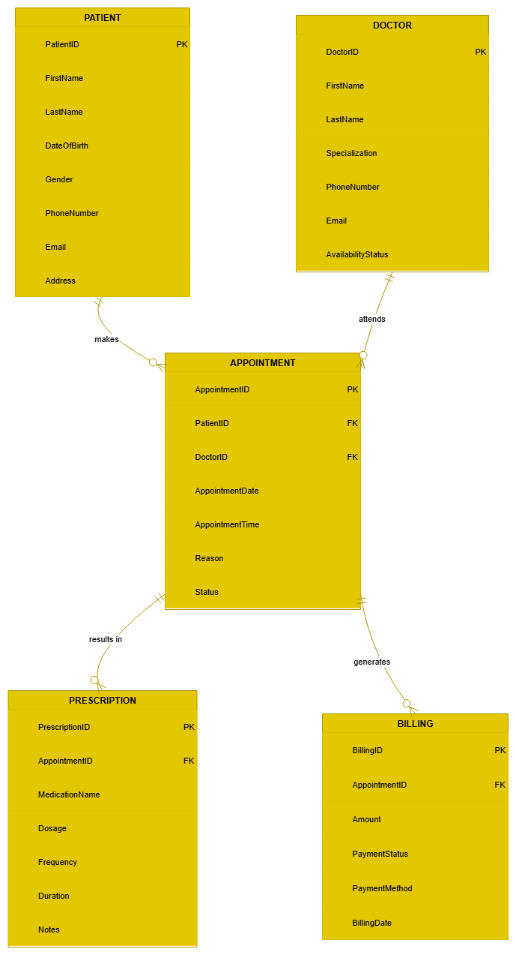
Part 2 : Database Design
Logical Model

Slide 7
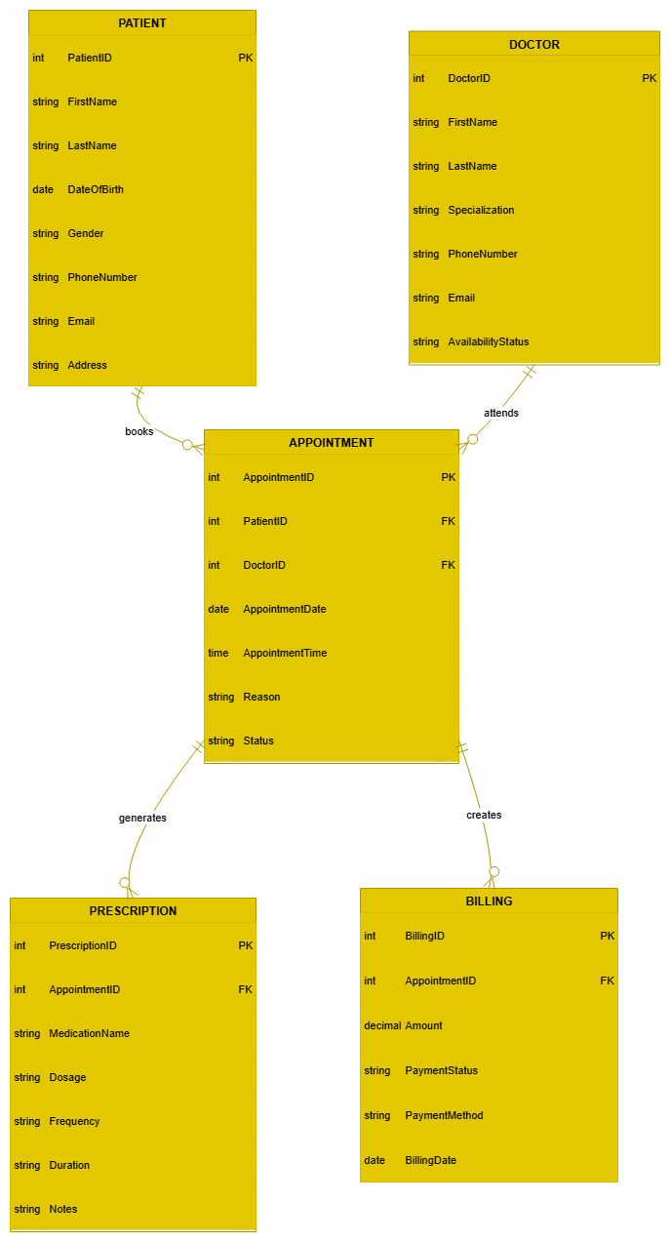
Part 2 : Database Design
Entity Relationship Model

Slide 8
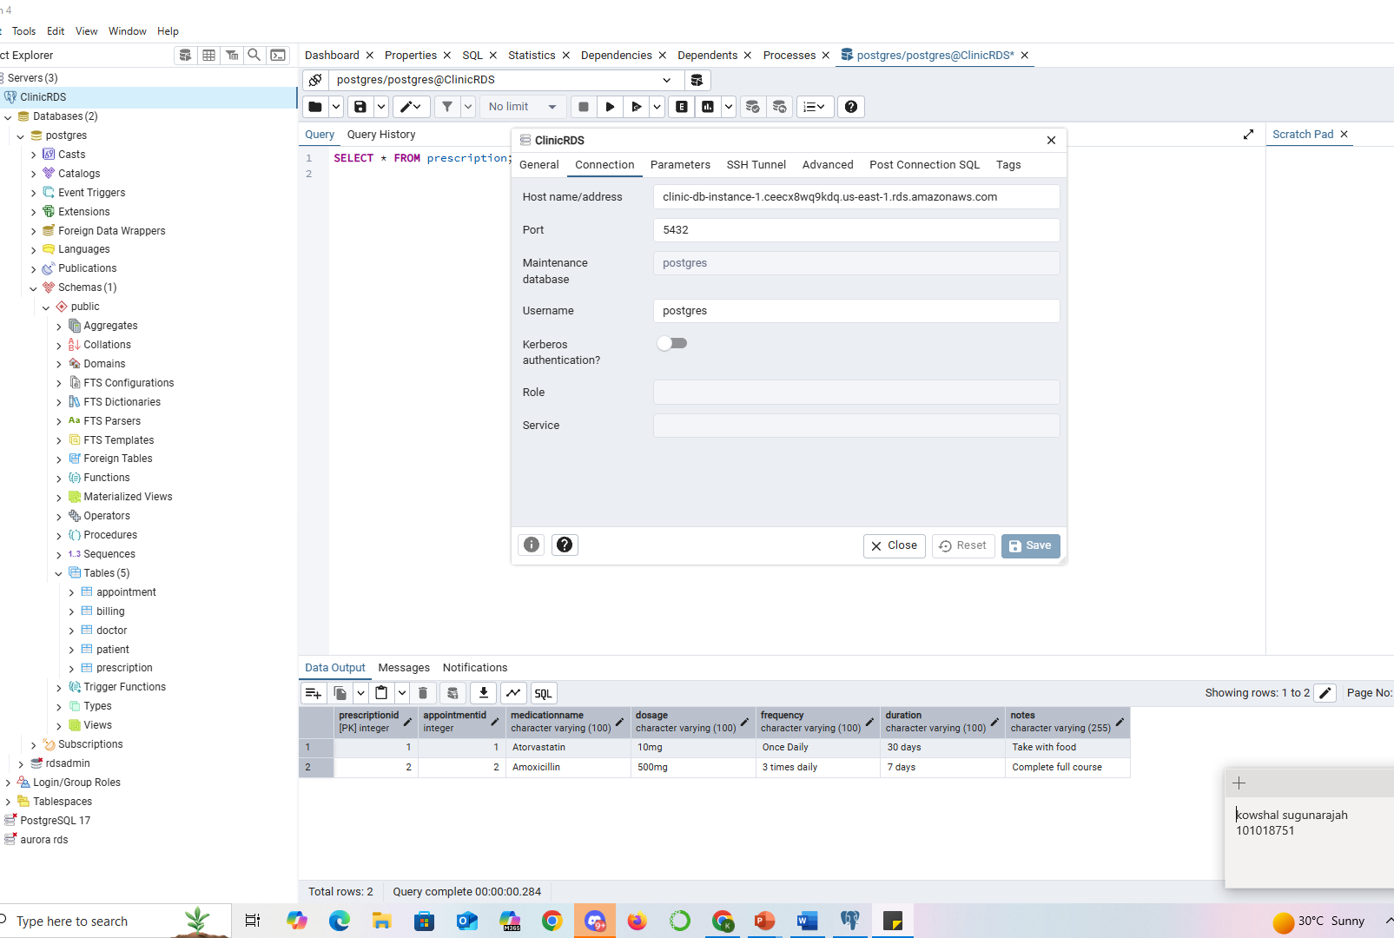
Aurora Postgre connection with pgadmin

Slide 9
Part 2 : Database Design
Physical Design
Creating Table Queries:
CREATE TABLE Patient ( PatientID INT PRIMARY KEY, FirstName VARCHAR(100), LastName VARCHAR(100), DateOfBirth DATE, Gender VARCHAR(10), PhoneNumber VARCHAR(20), Email VARCHAR(100), Address VARCHAR(255) ); | CREATE TABLE Doctor ( DoctorID INT PRIMARY KEY, FirstName VARCHAR(100), LastName VARCHAR(100), Specialization VARCHAR(100), PhoneNumber VARCHAR(20), Email VARCHAR(100), AvailabilityStatus VARCHAR(50) );
CREATE TABLE Appointment ( AppointmentID INT PRIMARY KEY, PatientID INT, DoctorID INT, AppointmentDate DATE, AppointmentTime TIME, Reason VARCHAR(255), Status VARCHAR(50), FOREIGN KEY (PatientID) REFERENCES Patient(PatientID), FOREIGN KEY (DoctorID) REFERENCES Doctor(DoctorID) ); | CREATE TABLE Prescription ( PrescriptionID INT PRIMARY KEY, AppointmentID INT, MedicationName VARCHAR(100), Dosage VARCHAR(100), Frequency VARCHAR(100), Duration VARCHAR(100), Notes VARCHAR(255), FOREIGN KEY (AppointmentID) REFERENCES Appointment(AppointmentID) );
CREATE TABLE Billing ( BillingID INT PRIMARY KEY, AppointmentID INT, Amount DECIMAL(10,2), PaymentStatus VARCHAR(50), PaymentMethod VARCHAR(50), BillingDate DATE, FOREIGN KEY (AppointmentID) REFERENCES Appointment(AppointmentID) );

Slide 10
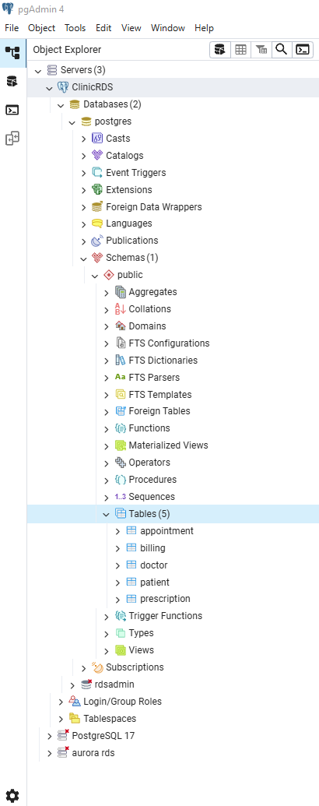
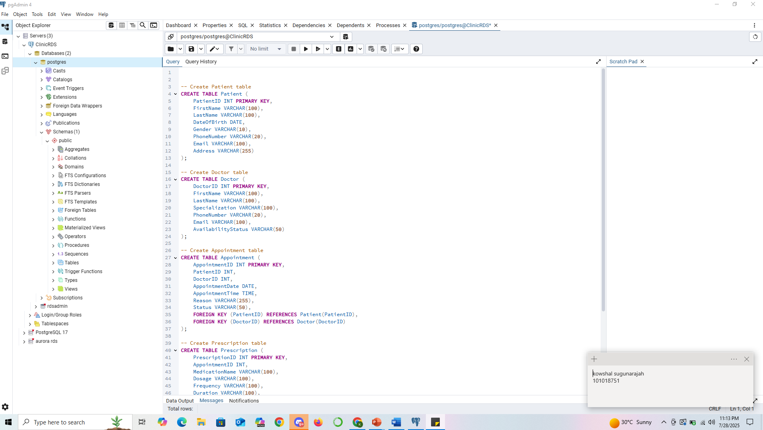
Part 2 : Database Design
Physical Design
Queries Result:

Slide 11
Part 2 : Database Design
Physical Design
Inserting Data Queries:
INSERT INTO Patient VALUES (1, 'John', 'Doe', '1990-05-12', 'Male', '555-1234', 'john@example.com', '123 Main St'), (2, 'Jane', 'Smith', '1985-09-30', 'Female', '555-5678', 'jane@example.com', '456 Oak Ave'); | INSERT INTO Doctor VALUES (1, 'Alice', 'Brown', 'Cardiology', '555-1111', 'alice@clinic.com', 'Available'), (2, 'Bob', 'Wilson', 'Pediatrics', '555-2222', 'bob@clinic.com', 'Available');
INSERT INTO Appointment VALUES (1, 1, 1, '2025-07-29', '10:00:00', 'Regular check-up', 'Scheduled'), (2, 2, 2, '2025-07-30', '14:30:00', 'Flu symptoms', 'Completed'); | INSERT INTO Prescription VALUES (1, 1, 'Atorvastatin', '10mg', 'Once Daily', '30 days', 'Take with food'), (2, 2, 'Amoxicillin', '500mg', '3 times daily', '7 days', 'Complete full course');
INSERT INTO Billing VALUES (1, 1, 120.00, 'Paid', 'Credit Card', '2025-07-29'), (2, 2, 75.00, 'Unpaid', 'Cash', '2025-07-30');

Slide 12
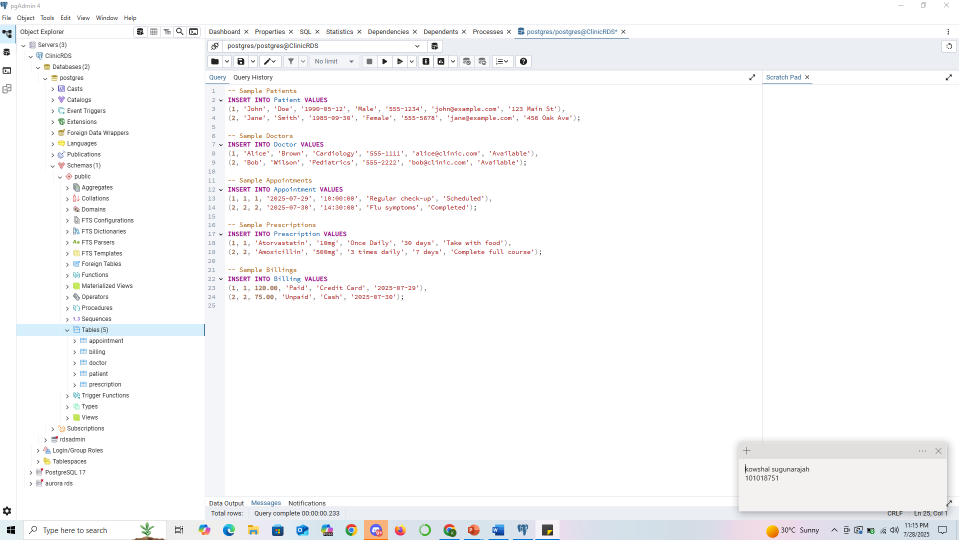
Part 2 : Database Design
Physical Design
Inserting Data Queries:

Slide 13
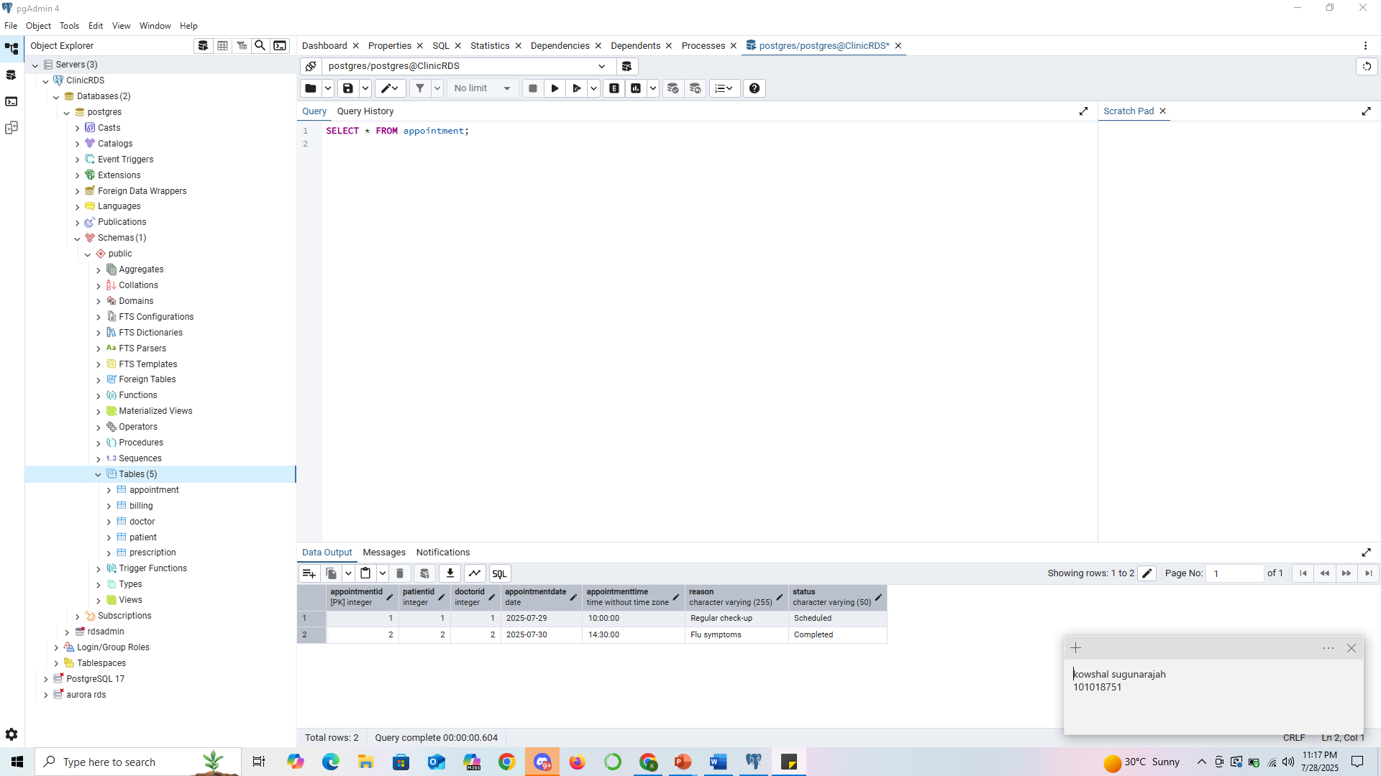
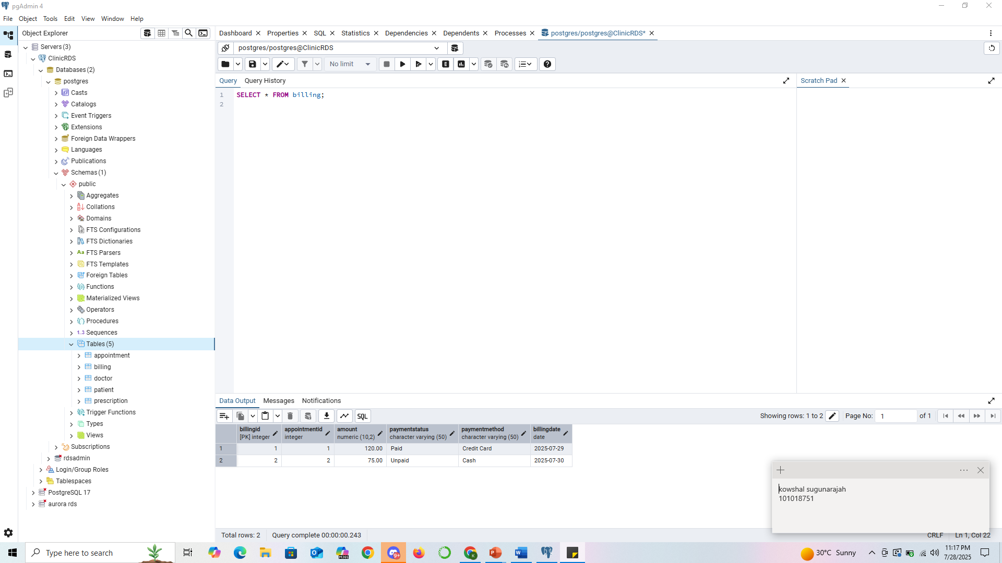
Part 2 : Database Design
Physical Design
Queries Result:

Slide 14
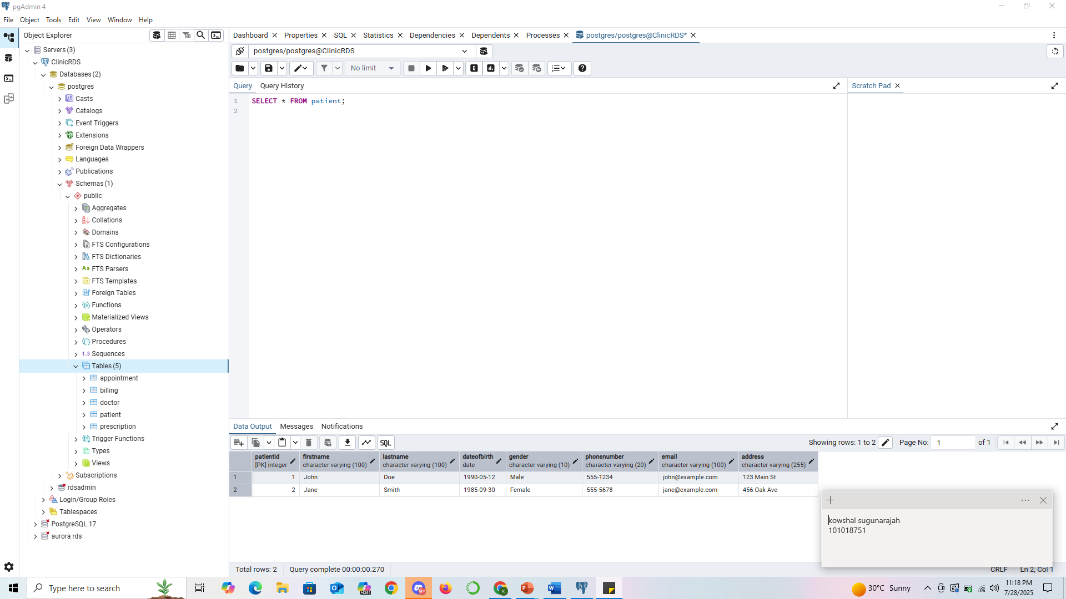
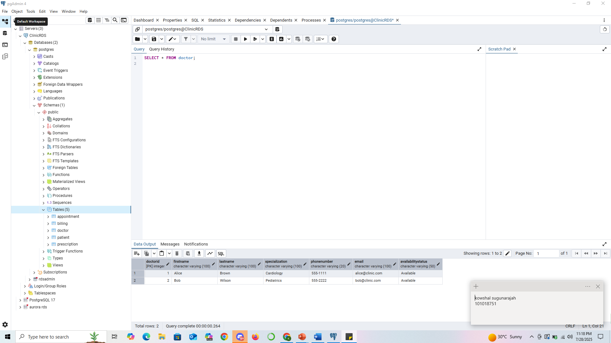
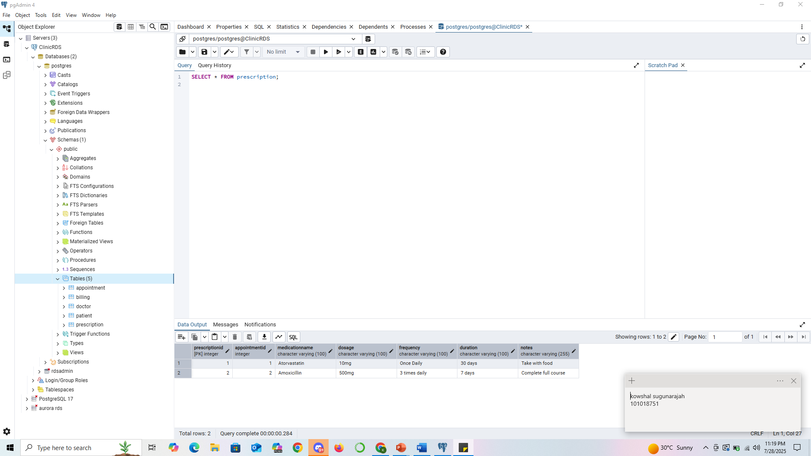
Part 2 : Database Design
Physical Design
Queries Result:

Slide 15
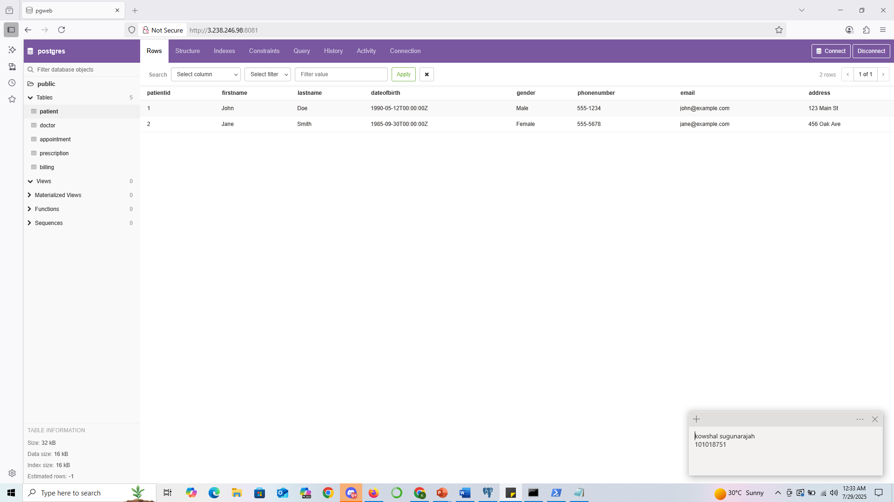
Showing data in pgweb

Slide 16
DynamoDB Deployment

Slide 17
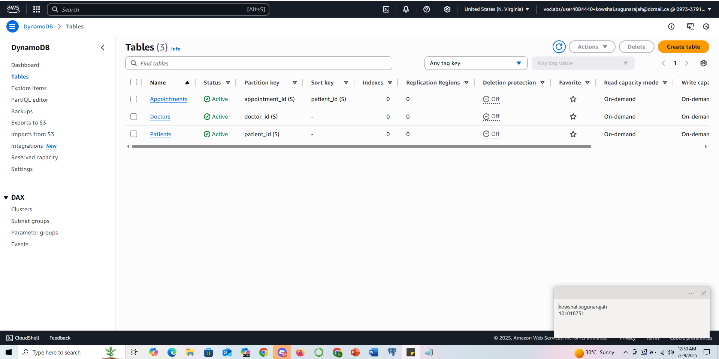
DynamoDB Deployment

Slide 18
DynamoDB Deployment
JSON Queries:
{ "patient_id": { "S": "P001" }, "name": { "S": "John Smith" }, "age": { "N": "45" }, "gender": { "S": "Male" }, "contact": { "S": "john@example.com" } } | { "doctor_id": { "S": "D001" }, "name": { "S": "Dr. Sarah Lee" }, "specialization": { "S": "Cardiologist" }, "contact": { "S": "sarah.lee@clinic.com" } }
{ "appointment_id": { "S": "A001" }, "patient_id": { "S": "P001" }, "doctor_id": { "S": "D001" }, "appointment_date": { "S": "2025-08-01" }, "status": { "S": "Scheduled" } } | { "prescription_id": { "S": "PR001" }, "appointment_id": { "S": "A001" }, "medicine": { "S": "Atorvastatin" }, "dosage": { "S": "10mg daily" }, "notes": { "S": "Take after food" } }

Slide 19
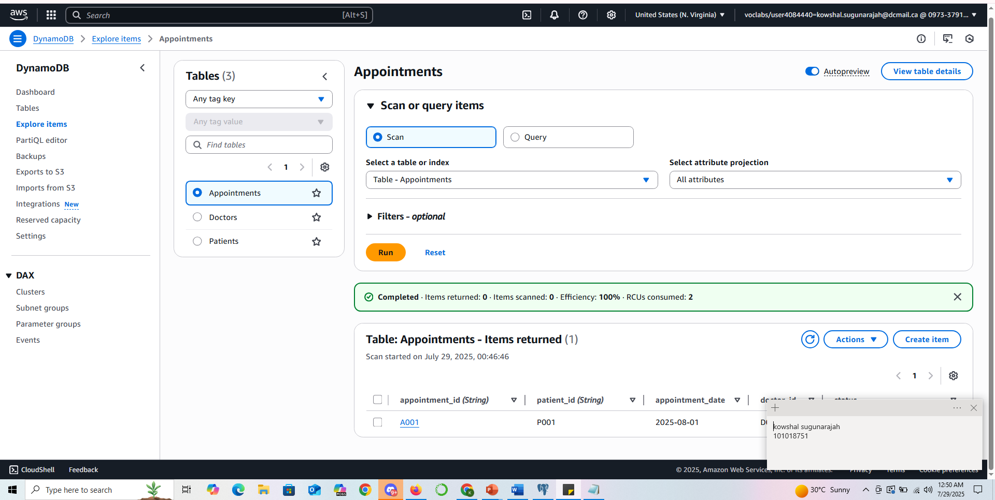
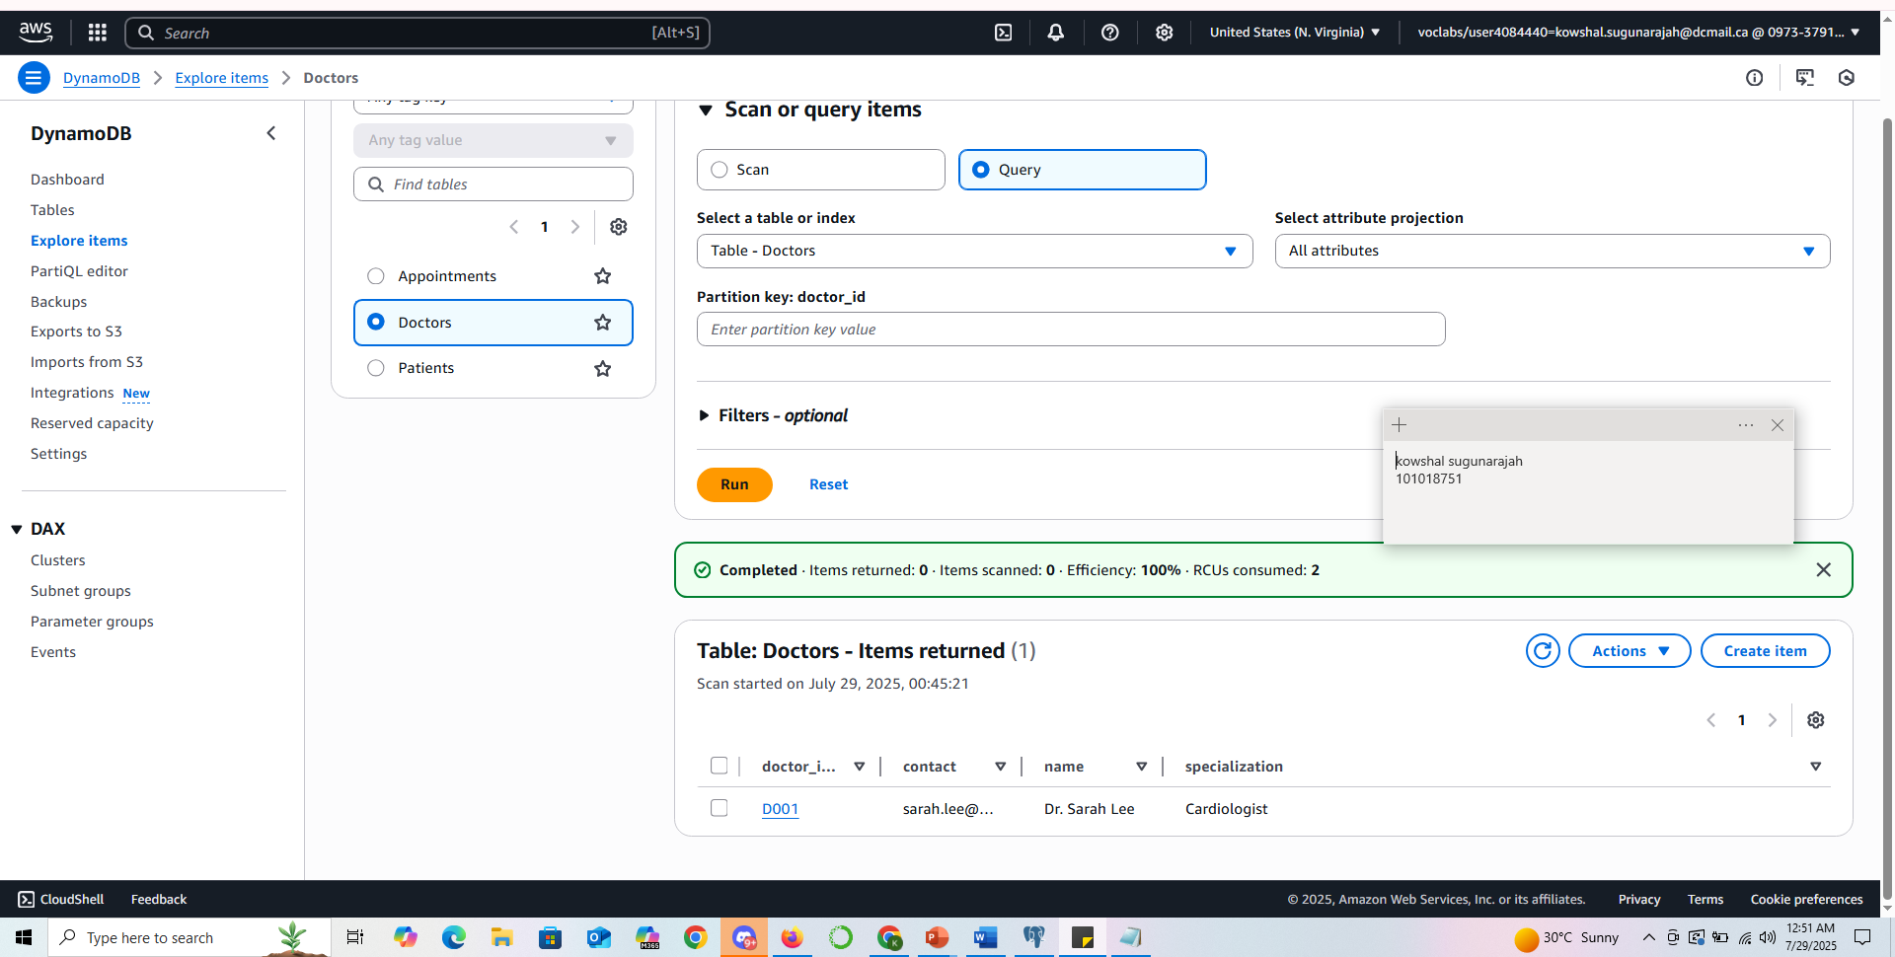
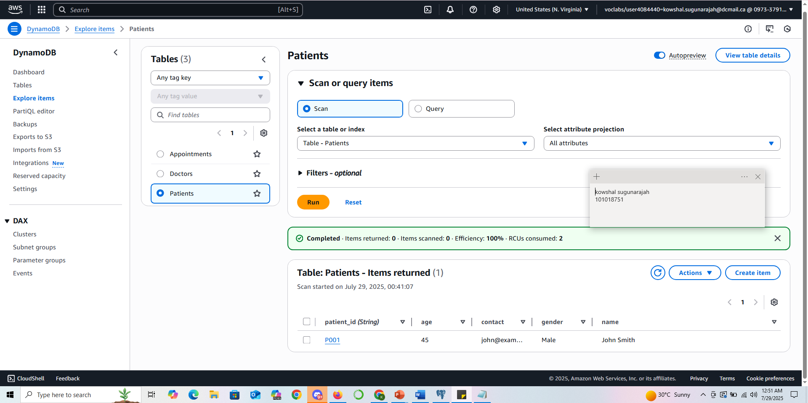
DynamoDB Deployment
JSON Queries Result:

Slide 20
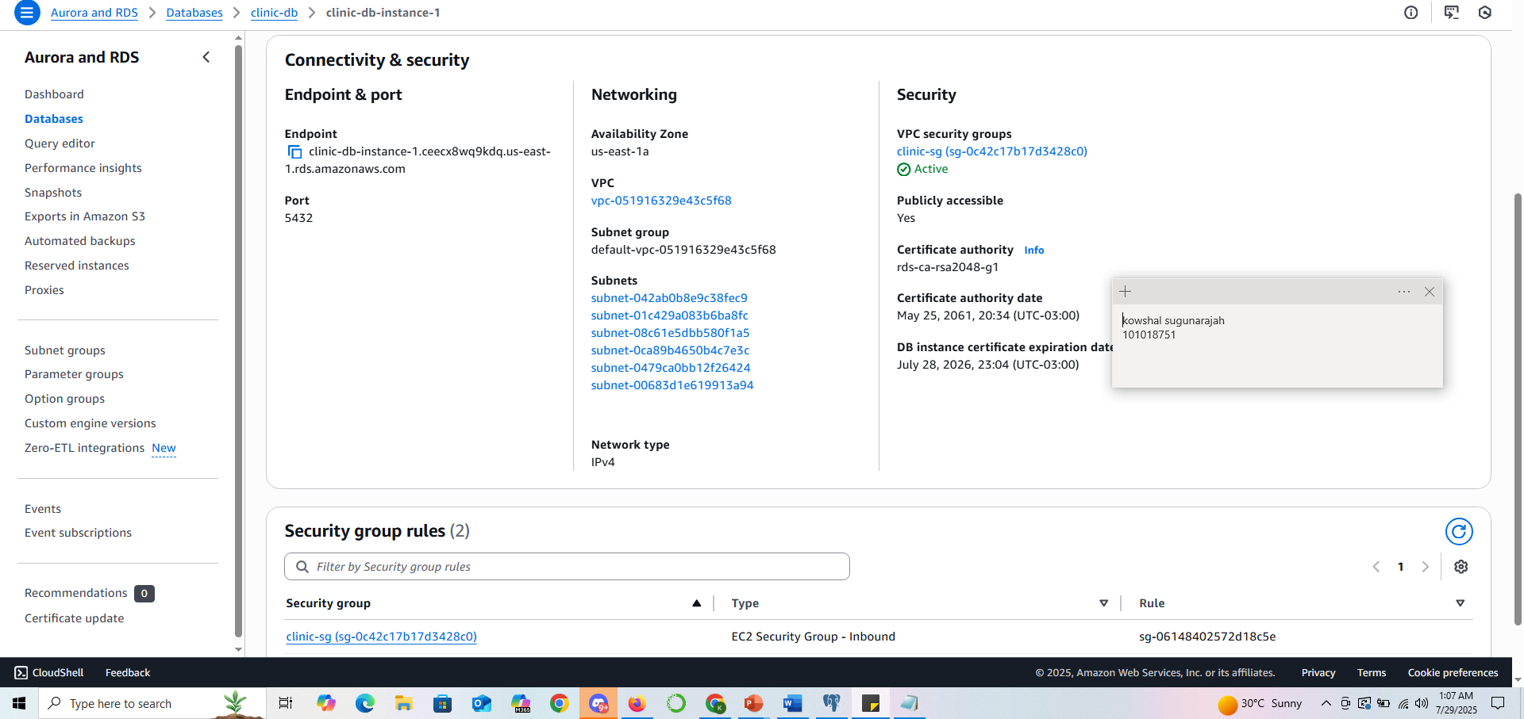
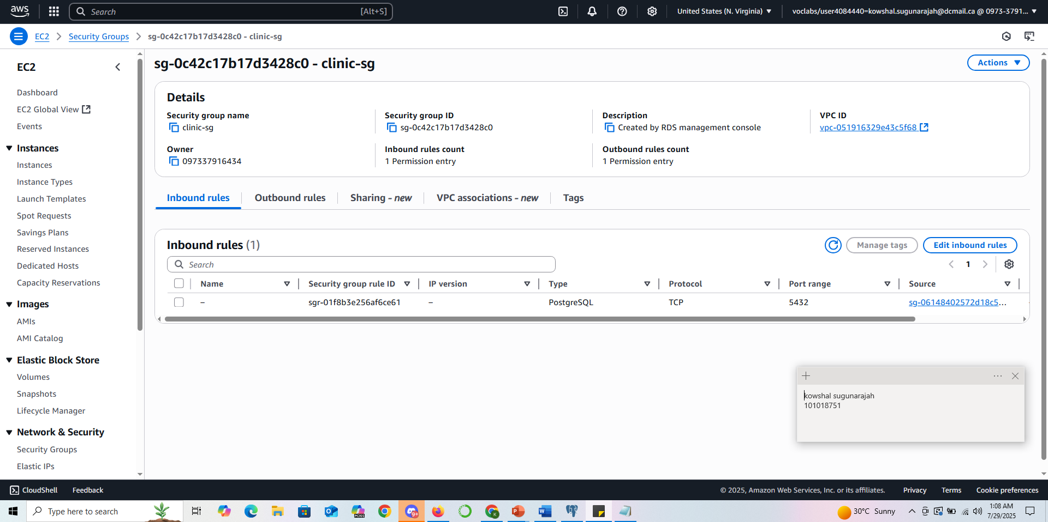
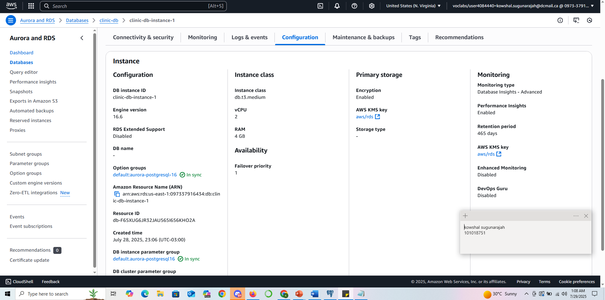
PART 4 : SECURITY SETTINGS FOR RDS

Slide 21
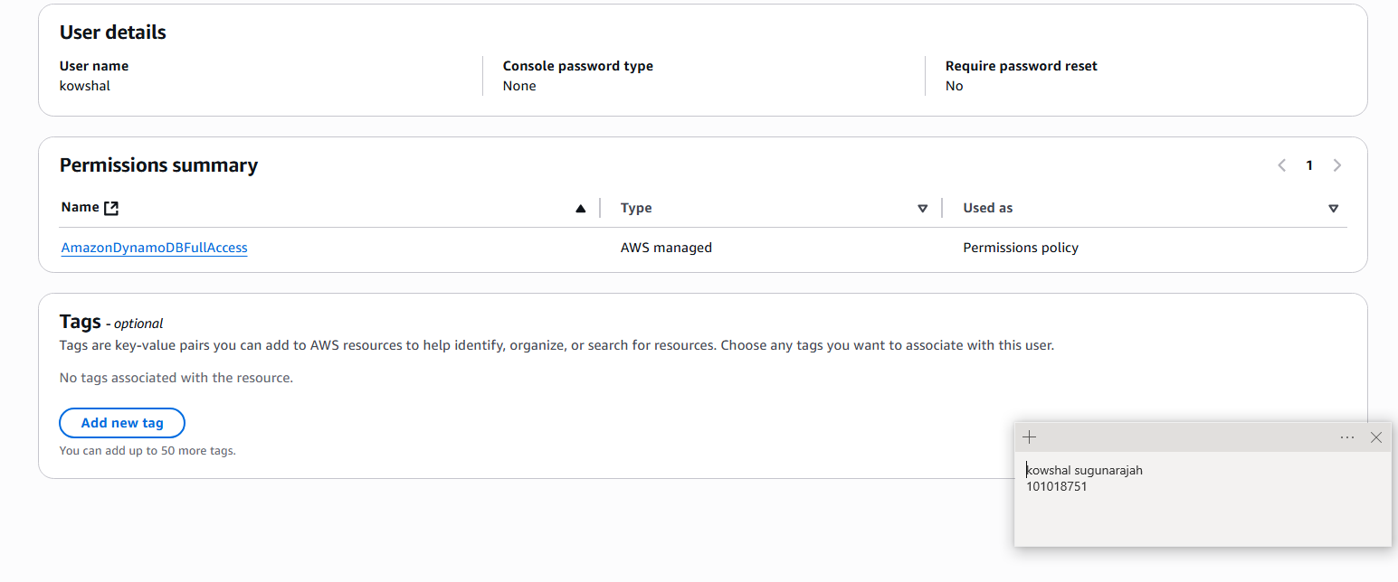
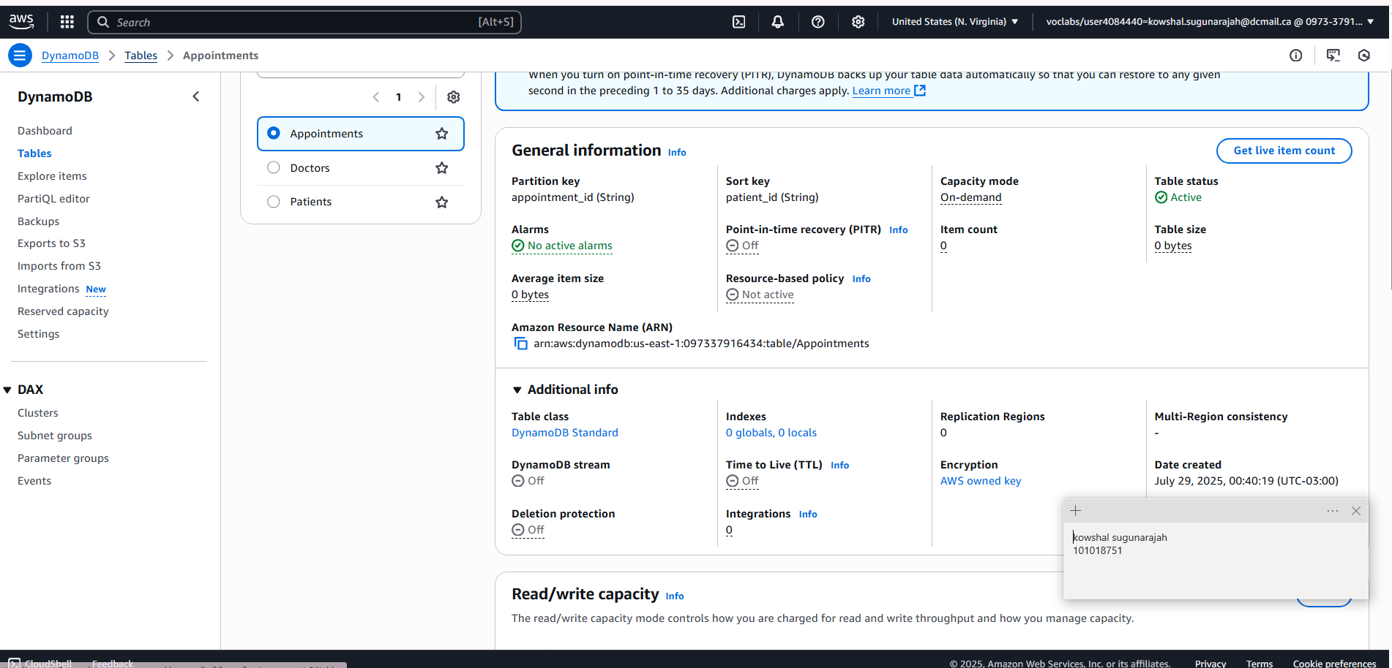
PART 4 : SECURITY SETTINGS FOR DYNAMO DB

Slide 22
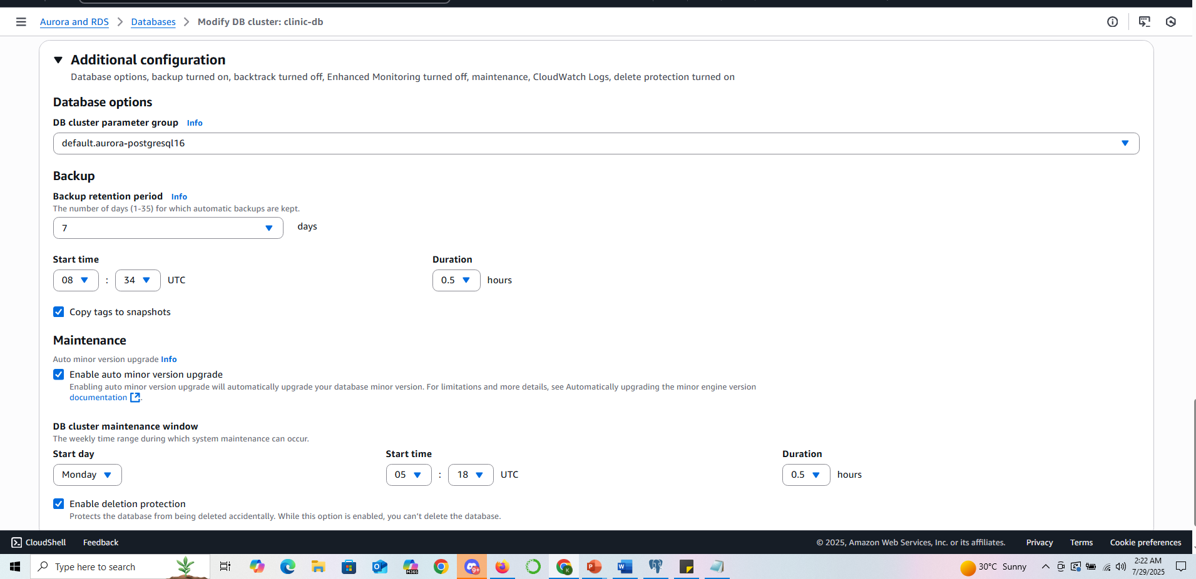
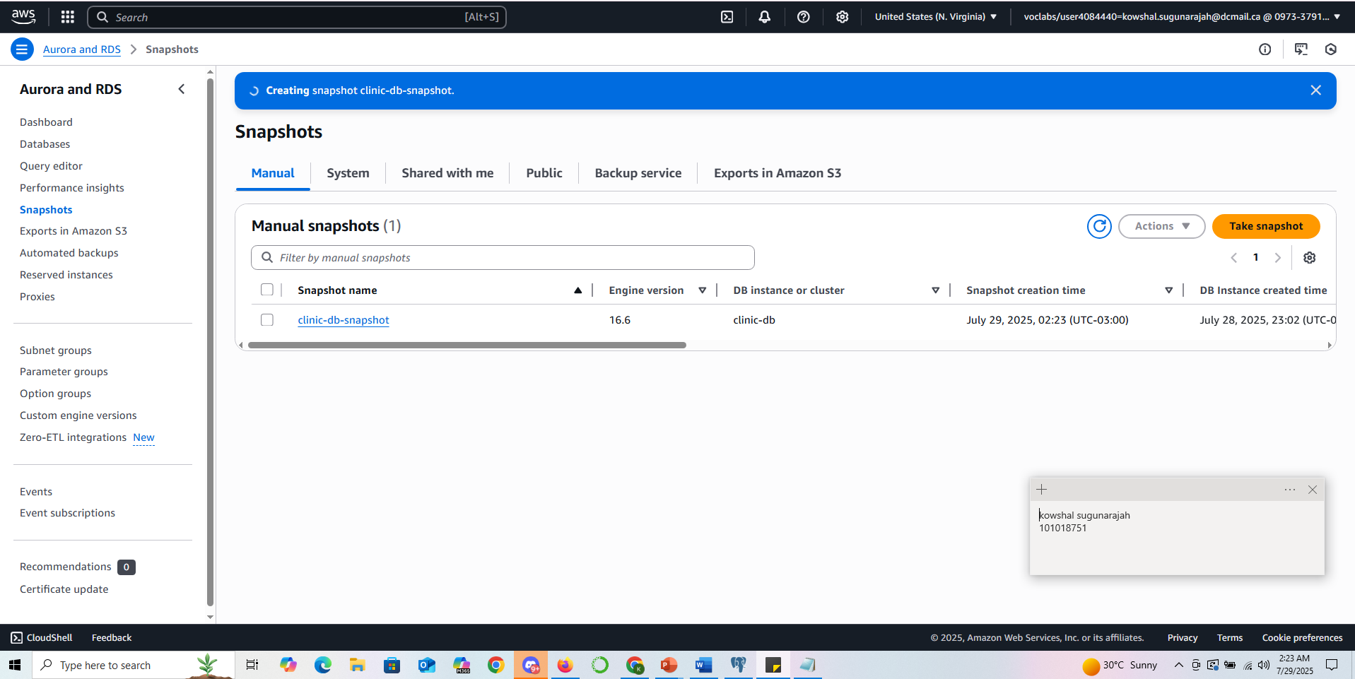
PART 4 : BACKUP MANAGEMENT FOR RDS

Slide 23
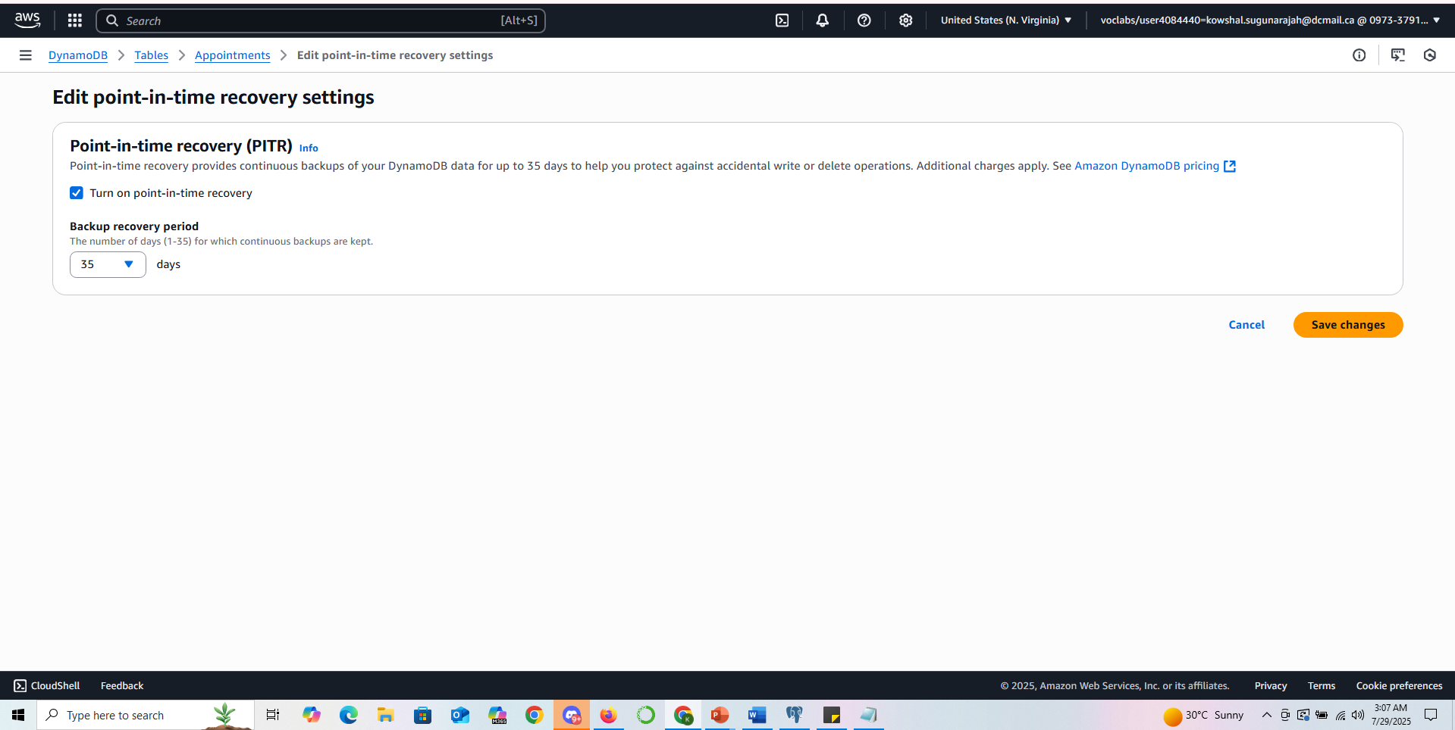
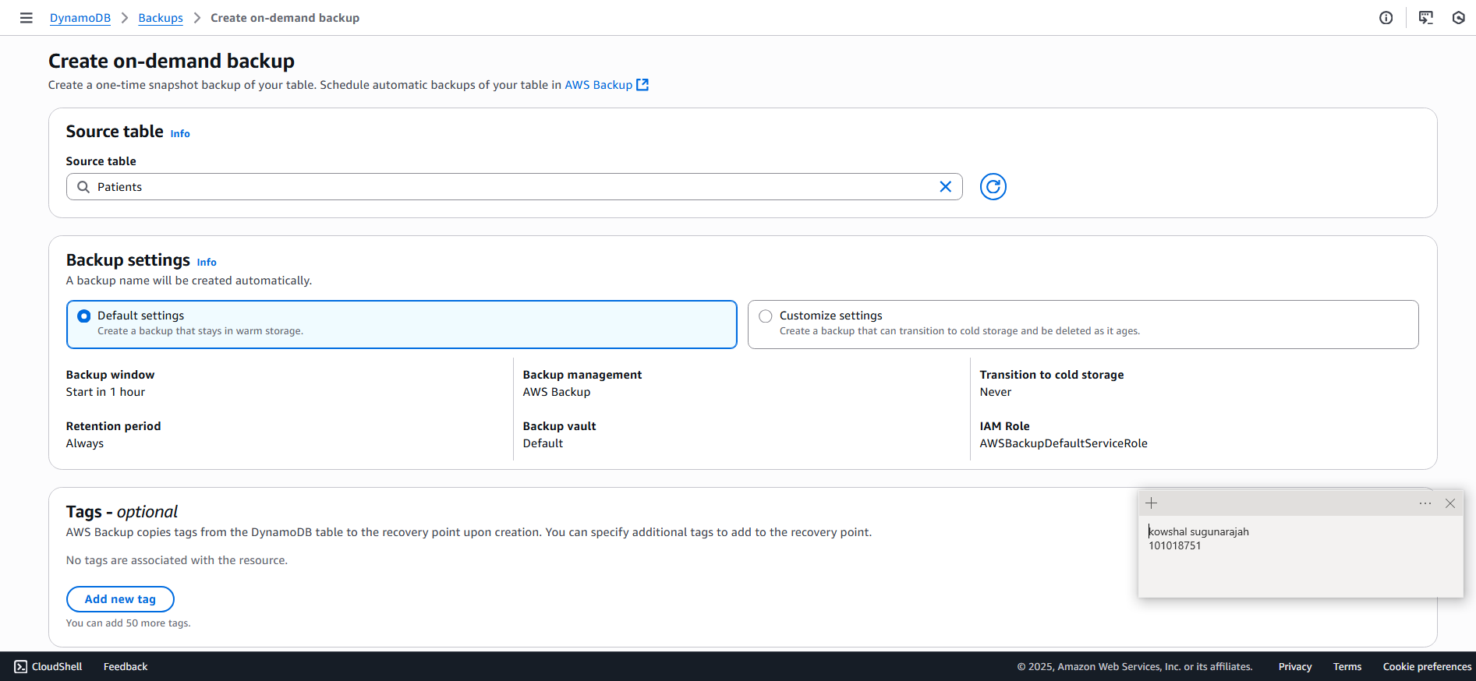
PART 4 : BACKUP MANAGEMENT FOR DYNAMO DB

Slide 24
Rationale
Security Settings Rationale: For the Aurora PostgreSQL database, I enabled encryption using the default AWS KMS key to protect data at rest. I limited access to the database using VPC and Security Groups, allowing only traffic from the bastion host (EC2) on port 5432. IAM roles were assigned for enhanced monitoring and to follow the principle of least privilege. For DynamoDB, encryption is enabled with AWS-owned keys for simplicity and compliance. IAM policies like AmazonDynamoDBFullAccess were applied only to the IAM user managing the tables to restrict unnecessary access. Backup Management Rationale: Automated backups were enabled for the RDS instance with a 7-day retention policy to allow recovery from any accidental data loss. I also created a manual snapshot for immediate restoration if needed. For DynamoDB, Point-in-Time Recovery (PITR) was enabled to allow continuous backups, and manual backups were created before any major data insertions. This ensures compliance with data recovery requirements and business continuity.

Slide 25
Rationale
APA References: Amazon Web Services. (n.d.). Amazon Aurora documentation. AWS Documentation. https://docs.aws.amazon.com/aurora/ Amazon Web Services. (n.d.). Amazon DynamoDB developer guide. AWS Documentation. https://docs.aws.amazon.com/amazondynamodb/latest/developerguide/Welcome.html Amazon Web Services. (n.d.). Managing Amazon RDS backups. AWS Documentation. https://docs.aws.amazon.com/AmazonRDS/latest/UserGuide/USER_WorkingWithAutomatedBackups.html Amazon Web Services. (n.d.). Best practices for securing your AWS environment. AWS Documentation. https://docs.aws.amazon.com/wellarchitected/latest/security-pillar/security-pillar.html Amazon Web Services. (n.d.). Amazon RDS security. AWS Documentation. https://docs.aws.amazon.com/AmazonRDS/latest/UserGuide/UsingWithRDS.html Amazon Web Services. (n.d.). Point-in-time recovery for DynamoDB. AWS Documentation. https://docs.aws.amazon.com/amazondynamodb/latest/developerguide/PointInTimeRecovery.html

Slide 26
Thank you

